Slide 1

Video Interview Analysis
Faculty of computer and information science
Ain shams University

Slide 2
Supervisors
Dr. mona abdelazim
Ta. Aya naser

Slide 3
Presented by
Mohamed samy
Yomna mohamed
Nadine Elkady
Ammar mohamed
Mohamed ashraf
Youssef tamer

Slide 4
agenda
Introduction
Problem definition
Our Objective
Related works
System architecture
references

Slide 5
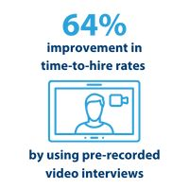
InTRODUCTION
The interview phase is a critical part of recruitment. Traditionally, in-person interviews were the standard for hiring, but the pandemic introduced video interviews for remote hiring. This shift has made the process faster, more cost-effective, and highly efficient.

Slide 6

Problem Definition

Slide 7

recruitment challenges
Time Inefficiency
HR staff spend as much as 57% of their time on administrative tasks, leaving little time for more strategic tasks.
Bias in Recruitment
Unconscious bias during interviews can lead to unfair hiring practices and missed opportunities for diverse talent.
Limited Use of Data
Not using data in hiring decisions can lead to bad hires, which means higher turnover and extra costs for recruiting and training.
Notes:
Strategic work → Modernizing HR: Design Thinking and New Technologies to Help Enhance Employee Experience

Slide 8

Objective
Reducing Bias in Hiring.
Reducing Time-to-Hire in High-Volume Recruitment.
Providing HR with Briefed Candidate Reports Through AI Video Interviews.
Facilitate Remote Hiring
Reduce Cost

Slide 9
Related works
Reference | Personality traits | English level | Facial expression | Text summarization
[1] Novel Framework for Job Interview Processing Automation Based on Intelligent Video Processing. | ✅ | ❌ | ❌ | ❌
[3] Transformer-based multi-aspect multi-granularity non native english speaker pronunciation assessment. | ❌ | ✅ | ❌ | ❌

Slide 10
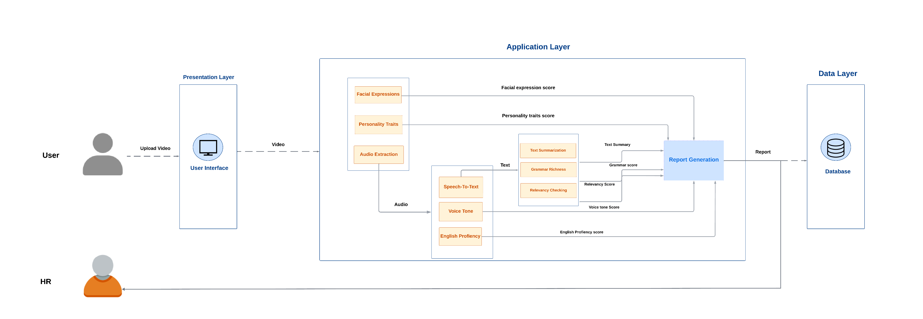
System architecture

Slide 11
References
[1] Kassab, Kenan, and Alexey Kashevnik. "Novel Framework for Job Interview Processing Automation Based on Intelligent Video Processing." 2024 35th Conference of Open Innovations Association (FRUCT). IEEE, 2024.
[2] Naim, Iftekhar, et al. "Automated analysis and prediction of job interview performance." IEEE Transactions on Affective Computing 9.2 (2016): 191-204.
[3] Gong, Yuan, et al. "Transformer-based multi-aspect multi-granularity non native english speaker pronunciation assessment." ICASSP 2022-2022 IEEE International Conference on Acoustics, Speech and Signal Processing (ICASSP). IEEE, 2022.
[4] Kim, Jin-Young, and WanGyu Heo. "Artificial intelligence video interviewing for employment: perspectives from applicants, companies, developer and academicians." Information Technology & People 35.3 (2022): 861-878.
[5] Lee, B. C., and B. Y. Kim. "Development of an AI-based interview system for remote hiring." International Journal of Advanced Research in Engineering and Technology (IJARET) 12.3 (2021): 654-663.
[6] Chen, Lei, et al. "Automated video interview judgment on a large-sized corpus collected online." 2017 Seventh International Conference on Affective Computing and Intelligent Interaction (ACII). IEEE, 2017.

Slide 12
AGENDA
Introduction
Building confidence
Engaging the audience
Visual aids
Final tips & takeaways

Slide 13
SELECTING VISUAL AIDS
ENHANCING YOUR PRESENTATION

Slide 14
NAVIGATING Q&A SESSIONS
Know your material in advance
Anticipate common questions
Rehearse your responses
Maintaining composure during the Q&A session is essential for projecting confidence and authority. Consider the following tips for staying composed:
Stay calm
Actively listen
Pause and reflect
Maintain eye contact

Slide 15
DYNAMIC DELIVERY
Learn to infuse energy into your delivery to leave a lasting impression
One of the goals of effective communication is to motivate your audience
Metric | Measurement | Target | Actual
Audience attendance | # of attendees | 150 | 120
Engagement duration | Minutes | 60 | 75
Q&A interaction | # of questions | 10 | 15
Positive feedback | Percentage (%) | 90 | 95
Rate of information retention | Percentage (%) | 80 | 85

Slide 16
FINAL TIPS & TAKEAWAYS
Consistent rehearsal
Strengthen your familiarity
Refine delivery style
Pacing, tone, and emphasis
Timing and transitions
Aim for seamless, professional delivery
Practice audience
Enlist colleagues to listen & provide feedback
Seek feedback
Reflect on performance
Explore new techniques
Set personal goals
Iterate and adapt

